Slide 1
Cloud System Management
Cloud Security Day 2

Slide 2
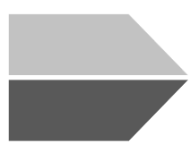

Class Objectives
By the end of today’s class, you will be able to:
Access your entire VNet from your jump box.
Install and run containers using Docker.
Set up Ansible connections to VMs inside your VNet.
‹#›
Notes:
shutterstock_1214853796

Slide 3

Make sure you’re using your personal Azure accounts today — not the cyberxsecurity accounts.

Slide 4
Cloud Computing Recap
In the previous class, we covered:
01
02
03
The different cloud services and the *aaS acronyms.
The unique challenges of securing cloud deployments and building security from the ground up.
How to set up a virtual network protected by a firewall with a virtual machine on that network.

Slide 5


At this time, the VM is still inaccessible because our firewall is blocking traffic to it.
‹#›
‹#›
Notes:
shutterstock_204345808

Slide 6
Today’s Class
Today, we’ll cover:
SSH connections and security group rules.
Containers, what they are, and their role in IT infrastructure.
Provisioners and their role in the larger concept of infrastructure as code.
Using Ansible to create infrastructure.
An introduction to network architecture and secure network design.

Slide 7
Containers, IaC, and Provisioners

Slide 8
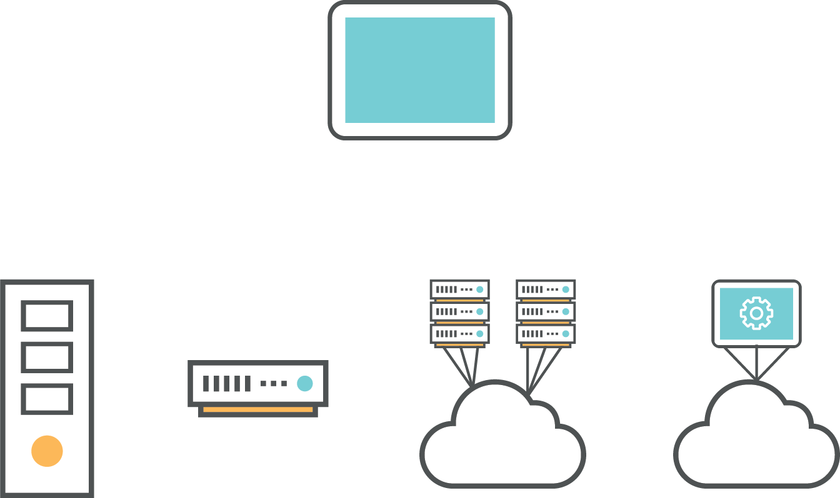
Containers, IaC, and Provisioners
Containers, infrastructure as code, and provisioners are new technologies that provide powerful solutions to some of the most difficult problems of infrastructure management.
Not all organizations leverage these tools fully.
But, nearly all organizations are aware of their value, and many are updating their processes and toolkits to make better use of them.
Infrastructure Management
Physical
Virtual
Private
Cloud
Public
Cloud
Notes:
shutterstock_274943486

Slide 9

Containers, IaC, and Provisioners
Potential employers will consider knowledge of containers, infrastructure as code, and automated provisioning valuable for both cloud-specific and "standard" systems/network administration roles.
Notes:
shutterstock_1256570869

Slide 10

Containers can be thought of as “lightweight VMs.”

Slide 11
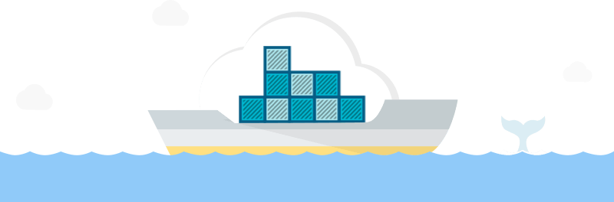
High-Level Overview: Containers
Containers are smaller than VMs (megabytes rather than gigabytes) and
require fewer CPU resources.
Because they are smaller, they can be downloaded and distributed more easily.
Since they’re cheap, more of them can be run.
They're also easier and faster to destroy and redeploy as needed.
(Google Containers)

Slide 12
Provisioners are tools that automatically configure VMs or containers for you.

Slide 13
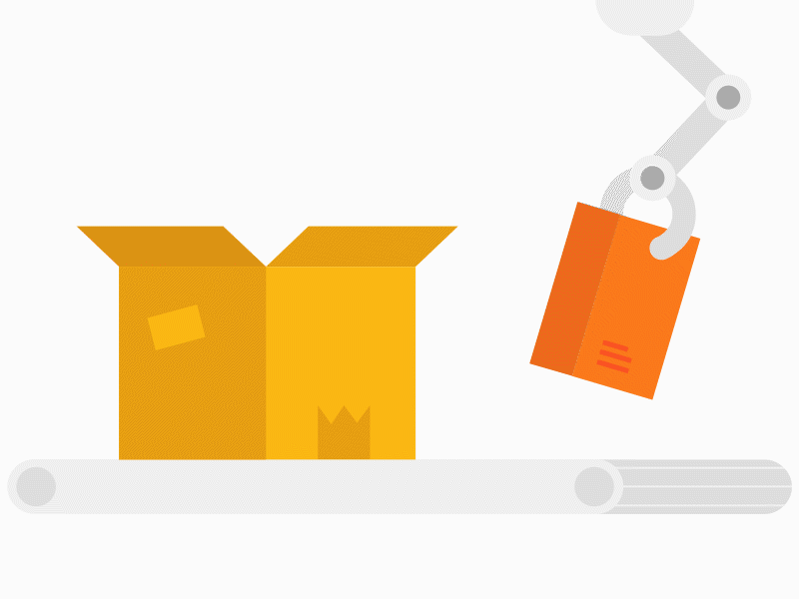
High-Level Overview: Provisioners
Instead of manually logging into a machine and issuing commands like apt get, or editing configuration files yourself, you can use a provisioner to do this automatically.
This drastically reduces the potential for human error and simplifies the process of configuring potentially thousands of machines identically all at once.
(Source)

Slide 14
Infrastructure as code (IaC) is the idea that the configurations for all of the VMs, containers, and networks in your deployment should be defined in text files, which you can use with provisioners to automatically recreate machines and networks whenever necessary.

Slide 15
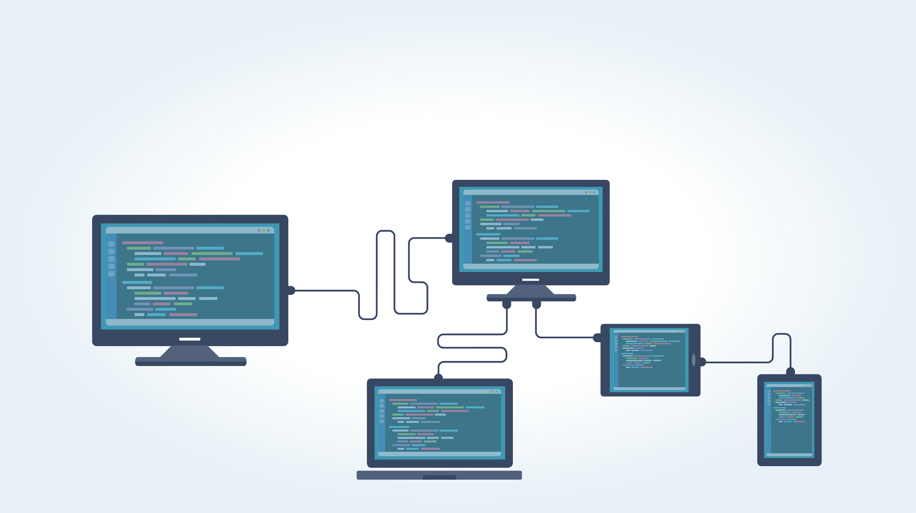
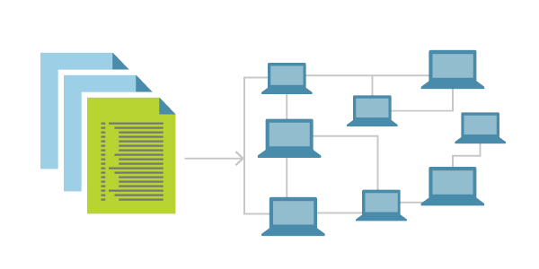
High-Level Overview: Infrastructure as Code
The primary benefit to IaC is that everyone can see exactly how the network is configured by reading text files. These can be easily version controlled with tools like Git, Apple Time Machine, or Microsoft OneDrive.
Notes:
AdobeStock_118280676

Slide 16
Continuous Integration/ Continuous Deployment (CI/CD) is the concept of automatically updating machines on your network whenever your IaC files change.

Slide 17

High-Level Overview: Infrastructure as Code
Whenever you change a machine’s configuration file:
Continuous Integration (CI) ensures that a new version of that machine is built immediately.
Continuous Deployment (CD) ensures that this new version is automatically deployed to your live environment.
The primary advantage to CI/CD is that it allows you to manage your entire network simply by updating IaC text files.
Notes:
AdobeStock_286685511

Slide 18
Foundations of Network Architecture

Slide 19
Remember: Our virtual machine is not accessible because our security group firewall is blocking all traffic to it.
This is to ensure that no one can possibly gain access to the VM.

Slide 20
Secure Configuration and Secure Architecture
This is an example of “secure configuration,” as opposed to “secure architecture.”
 | Secure Configuration | Secure Architecture
Ensures that…. | An individual VM or network is protected from intrusion using well-considered rules, such as access control policies and firewall rules. | A poorly configured or malfunctioning individual machine can only cause a limited amount of damage.
Is secure because... | It follows the right rules. | It is “structurally sound.” In other words: Secure architecture deters and contains the effects of a breach, ensuring that even insecure machines are hard to compromise, and that damage to a single machine doesn't take down the entire network.

Slide 21
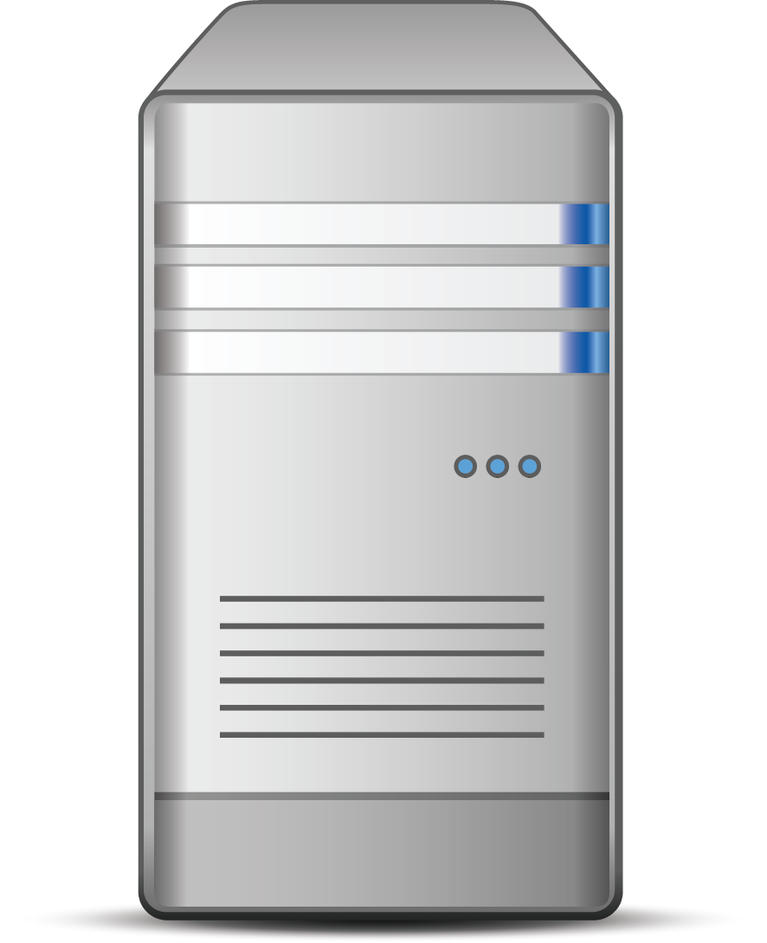


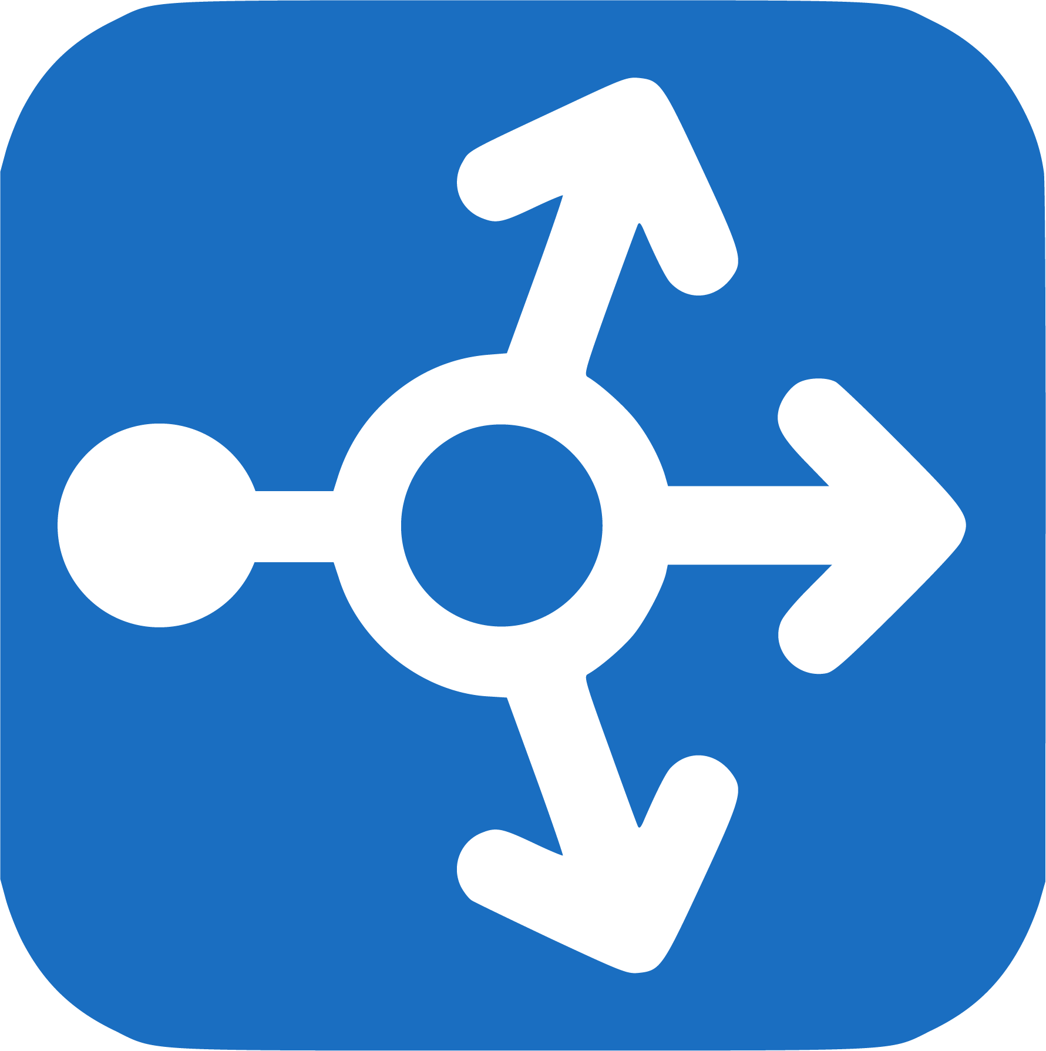
For example:
A network that is hidden behind a gateway router is secure because of its architecture.
Client 1
Gateway
Internet
Client 2
Client 3
Rather than exposing every machine directly to the public internet, machines have to first send traffic to the single router, which then forwards traffic to the machines behind it.
This allows security personnel to implement strong access controls on a single machine (the router) rather than on every individual VM, drastically reducing the attack surface.

Slide 22

Secure Configuration and Secure Architecture
While secure configuration and secure architecture promote security in different ways, they must work together.
Secure configuration is setting secure “rules” for individual machines and networks.
Secure architecture is connecting these individual machines and networks in safe ways.
Secure architecture can effectively mitigate the fallout of a breach.
But, the machines deployed according to that architecture must be securely configured in order for the architecture to fully deliver its security guarantees.

Slide 23
Network Redundancy

Slide 24
Network Redundancy
Important cloud security concepts include fault tolerance and redundancy.
A fault tolerant system can keep running even if one or more components within the system fail.
These systems continue to run because of redundancy: creating duplications of critical components or systems.
If one system or component is lost or compromised, a redundant system or component can step in and keep the system going.
From a security standpoint, this directly affects the reliability and availability of a system.

Slide 25
When making decisions about network architecture, we should always consider the amount of redundancy needed versus the amount of budget available.

Slide 26
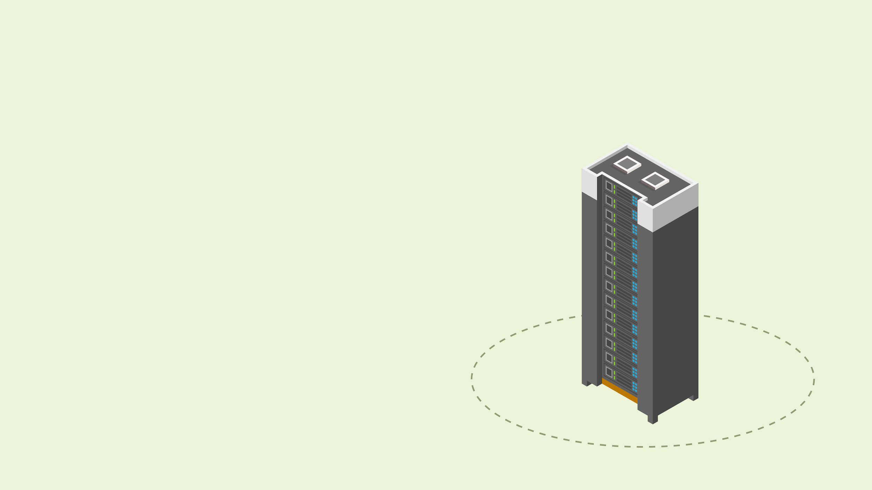
Redundancy vs. Budget
Creating redundant systems for everything may be advisable from an engineering standpoint, but not every administrator will have the budget to do so.
If Amazon was only running on one server, and the server went down, it would likely lose millions of dollars during downtime.
It wouldn’t make sense for a smaller web company to invest in the infrastructure needed to support a site like Amazon.
The company would likely go out of business due to unsustainable operational costs.

Slide 27

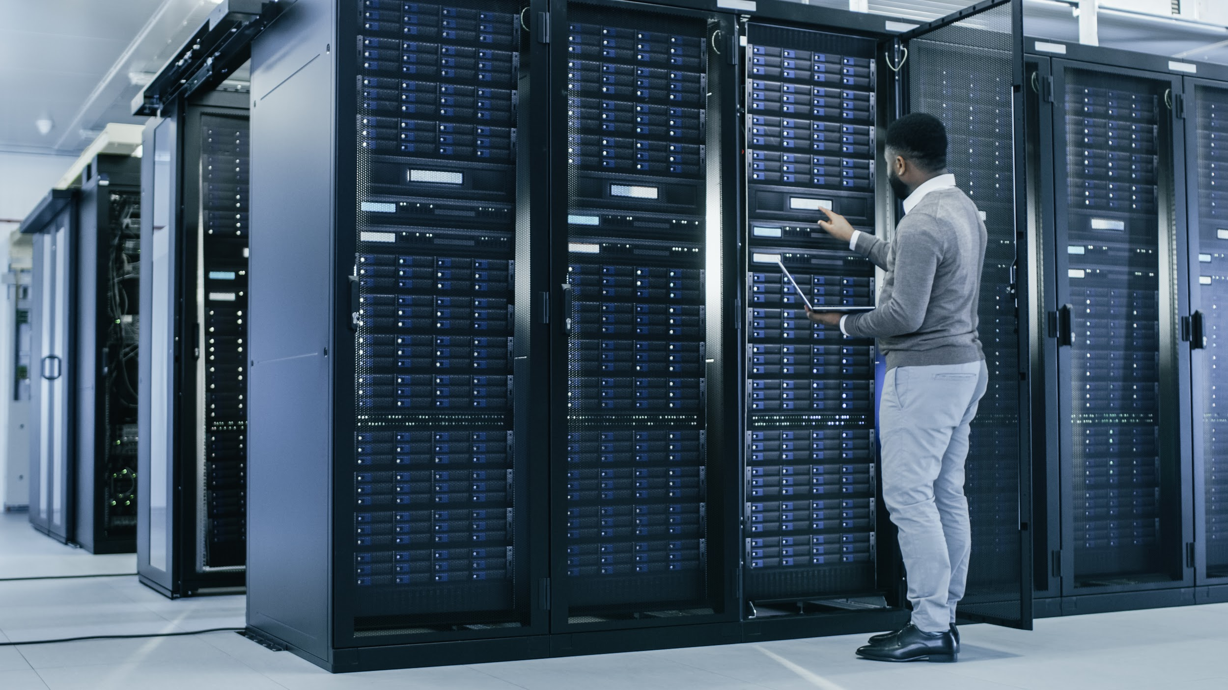
So where does the cloud come in?
Cloud services allow a company to add resources as needed, scaling infrastructure as the business grows and only paying for what they need.

Slide 28
Activity: Cloud Architecture
In this activity, you will decide which network architectures work best for each given scenario.
15 Minutes

Slide 29
Jump Box Administration

Slide 30
Now, we’ll apply secure architecture methods to our jump box configurations.

Slide 31
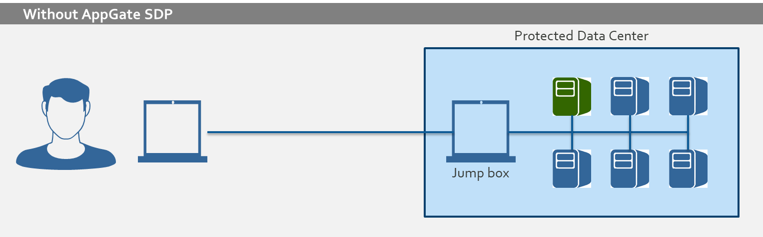


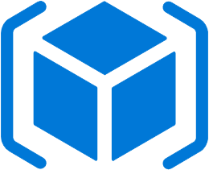

Fanning In
Placing a gateway router between VMs on a network forces all traffic through a single node. Securing and monitoring this single node is called fanning in.
By focusing on the interactions between the routers instead of all of the machines, we only have to worry about a few connections between a few machines, rather than connections between all machines.
Protected Data Center
Jump-box
Notes:
shutterstock_708417874(server icon)

Slide 32
Fanning In
In this diagram, a jump box is essentially identical to a gateway router.
The jump box is exposed to the public internet. In the classroom, we will be able to connect to the jump box’s SSH port (22).
It sits in front of other machines that are not exposed to the public internet.
It controls access to the other machines by allowing connections from specific IP addresses and forwarding to those machines.
Protected Data Center
Jump-box

Slide 33
Further Steps
While this architecture is secure enough, we can and should further harden setups by:
Limiting the number of machines that our jump box can access.
Locking the root account and limiting sudo access of the admin account on the jump box.
Implementing log monitoring on the jump box.
Implementing two-factor authentication for SSH login to the jump box.
Implementing a host firewall (UFW or IPtables) on the jump box.
Limiting jump box network access with a virtual private network (VPN).

Slide 34

We can configure a virtual private network (VPN) to securely connect to a cloud network.
Notes:
AdobeStock_174903598.jpg

Slide 35
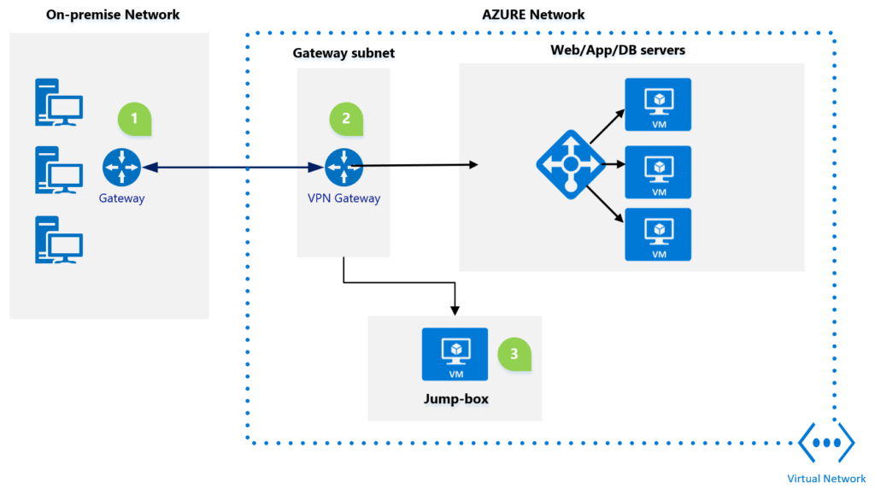

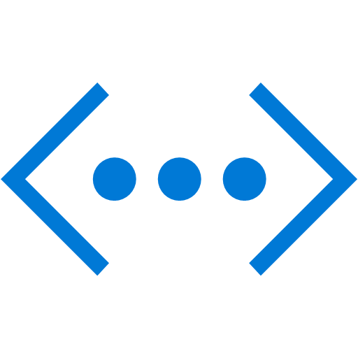
Virtual Private Networks
A virtual private network (VPN) creates a direct connection between your local network and a remote network.
Azure Network
Web/App/DB Servers
On-Premises Network
Gateway Subnet
Virtual Machines
Gateway
VPN Gateway
Jump Box
Virtual Network
Notes:
http://www.techbubbles.com/wp-content/uploads/2019/02/s2s-VPN-1-1024x579.png

Slide 36
Virtual Private Networks
A VPN can encrypt all network traffic between your current network and your remote network.
Azure Network
01
Web/App/DB Servers
On-Premises Network
Gateway Subnet
Virtual Machines
Gateway
VPN Gateway
Jump Box
Virtual Network
Notes:
http://www.techbubbles.com/wp-content/uploads/2019/02/s2s-VPN-1-1024x579.png

Slide 37
Virtual Private Networks
Once you are connected to the VPN, you have full access to all resources on the remote network, as if you were locally connected.
02
Azure Network
Web/App/DB Servers
On-Premises Network
Gateway Subnet
Virtual Machines
Gateway
VPN Gateway
Jump Box
Virtual Network
Notes:
http://www.techbubbles.com/wp-content/uploads/2019/02/s2s-VPN-1-1024x579.png

Slide 38
Virtual Private Networks
Many companies use VPNs to allow remote workers access to computers and servers that would otherwise only be accessible from the local network.
Azure Network
Web/App/DB Servers
On-Premises Network
Gateway Subnet
Virtual Machines
Gateway
VPN Gateway
03
Jump Box
Virtual Network
Notes:
http://www.techbubbles.com/wp-content/uploads/2019/02/s2s-VPN-1-1024x579.png

Slide 39
Activity: Jump Box Administration
In this activity, you will create a security group rule to allow SSH connections only from your current IP address and connect to your new virtual machine for management.
15 Minutes

Slide 40
Containers

Slide 41
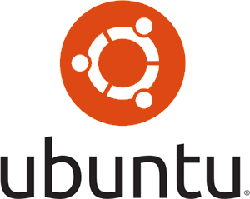


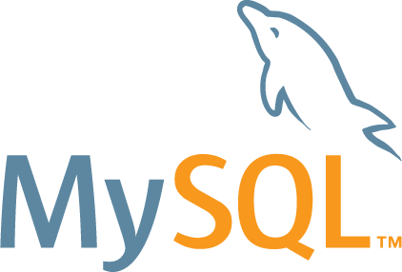

Containers
Configuring machines may require downloading and installing different applications to work together. For example, when configuring a LAMP web server, you will need to install:
Linux
A web server like Apache
For each of these items to work together, they need to be properly configured, which can be a time consuming process.
A database like MYSQL
A back-end codebase like PHP

Slide 42
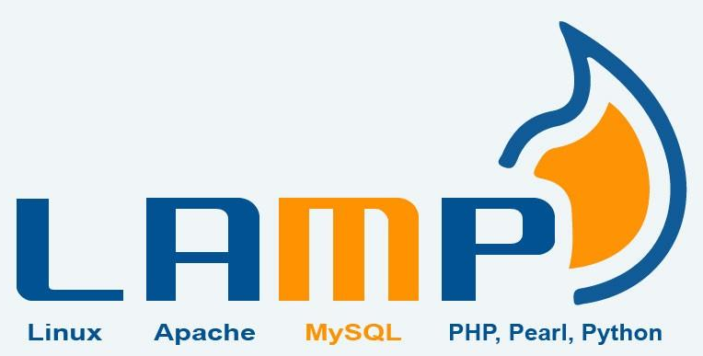
Containers
We can use VMs to configure a single LAMP server by:
Setting up a VM as a LAMP server.
Capturing an image of this VM.
Duplicating this image whenever a new LAMP server is needed.

Slide 43

Containers
However, this method is “heavy.” VMs are large and take a long time to download and deploy.
Additionally, if you clone an entire VM, most of the VM is “wasted space.”
Only a few files on the entire disk are actually relevant to running the LAMP server.
The rest are just operating system files.
Notes:
shutterstock_110537546

Slide 44

Containers
It is more efficient if web servers share common resources like the OS kernel and core libraries, and are only individually responsible for maintaining what is different between them, such as the data in their databases.
Notes:
shutterstock_743491903

Slide 45
Containers are essentially lightweight VMs. These act as VMs but are smaller and use fewer resources by sharing the resources they have in common with other containers.

Slide 46
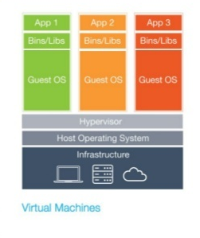

Containers vs. VMs
Like VMs, containers are simulated machines that run on a single host. However, two separate VMs running on the same host are completely independent of each other.
Virtual Machine A
Virtual Machine B
Virtual Machine C
App 1
App 1
App 1
Bins/Libs
Bins/Libs
Bins/Libs
Guest OS
Guest OS
Guest OS
Virtual Machine A has no knowledge of Virtual Machine B, even if Virtual Machine A and B were created from identical images.
Hypervisor
Host Operating System
Infrastructure
Notes:
Shutterstock_733601629
https://www.aquasec.com/wiki/download/attachments/2854029/docker-birthday-3-intro-to-docker-slides-18-638.jpg?version=1&modificationDate=1515522843003&api=v2

Slide 47
Containers vs. VMs
But, containers can share certain files. Container A, Container B, and Container C can run on a single host and use the same kernel.
Container A
Container B
Container C
App 1
App 1
App 1
Bins/Libs
Bins/Libs
Bins/Libs
They share these files and therefore only have to individually contain the files relevant to their applications, such as the LAMP server.
Docker Engine
Operating System
Infrastructure
Notes:
shutterstock_733601629

Slide 48
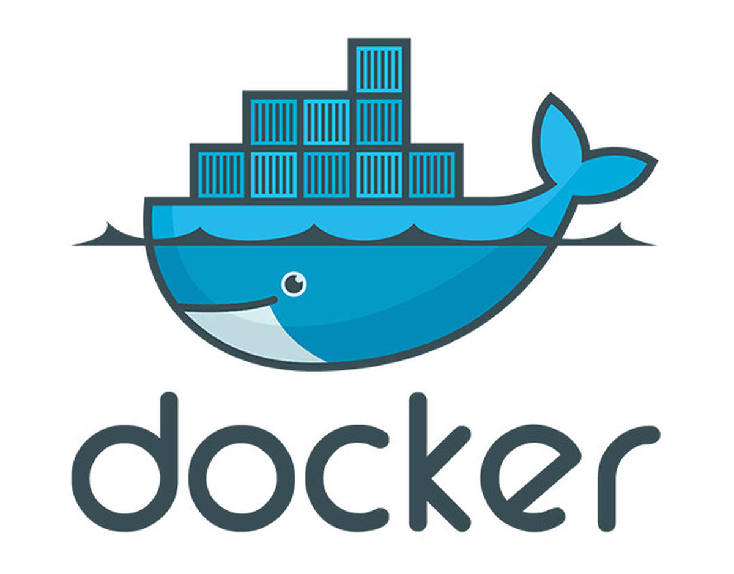

Containers
Linux
Linux
Linux
Linux
Azure VM
Azure VM
Azure VM
Azure VM
Hypervisor OS (Usually Linux-based)
Physical Datacenter Server (aka “Bare Metal” server)

Slide 49
Benefits of Containers
Benefits
Lightweight | They are much lighter weight than virtual machines because they don't need to virtualize all computer hardware and don't need to run their own OS.
Share resources | Containers intelligently share OS resources while remaining isolated, allowing each one to focus exclusively on its own state.
Specialized | Containers only run the software components that they need to complete their task. Containers only do one thing.
Easily duplicated | A copy or image of a container can be easily downloaded and shared from computer to computer.
Prevalent and redundant | Containers are widely used in today's web architecture.

Slide 50

Containers and VMs
VMs and containers are used together. Usually an administrator will provision a powerful VM and then run many containers on it.
Linux
Azure VM

Slide 51
Using containers instead of VMs to run a LAMP server will immediately result in massive cost and operational savings. But, they still have to maintain their own data.

Slide 52
Stateless vs. Stateful Containers
Containers are stateful. We can’t safely destroy a container and replace it with a new one if it contains data that no other instance has.
Therefore, we need to make containers as stateless as possible, by moving data to its own central location and extracting server/application logic as much as possible.
Stateless
Moving data to own central location
Extracting server and application logic
Stateful

Slide 53
As Stateless As Possible
In our LAMP container example, we can split the container into a set of multiple containers: one responsible for the database (MySQL) and one responsible for the web server (Linux/Apache).
Web Server Containers
Database Containers
Networking
If we have a sudden increase in the number of users accessing our site, we can accommodate by creating even more application/server containers and linking them to the database container.

Slide 54
Scaling
Creating more containers to handle additional load is called horizontal scaling. This is different from vertical scaling, where we simply make an existing machine more powerful by adding more RAM or CPU.
Vertical Scaling
Increase size of instance (RAM, CPU, etc.)
Horizontal Scaling
Add more instances

Slide 55
Horizontal Scaling
Horizontal scaling is vastly preferable to and more flexible than vertical scaling.
In real world practice, both vertical and horizontal scaling is used.
Horizontal scaling makes the system more resilient.
Multiple machines (or containers) prevent a single point of failure, as you can redirect requests to the other machines as needed.
Vertical scaling has a limit.
You can only add so much RAM and CPU to one computer before you run out of resources.

Slide 56
is the most common program used to manage containers.

Slide 57
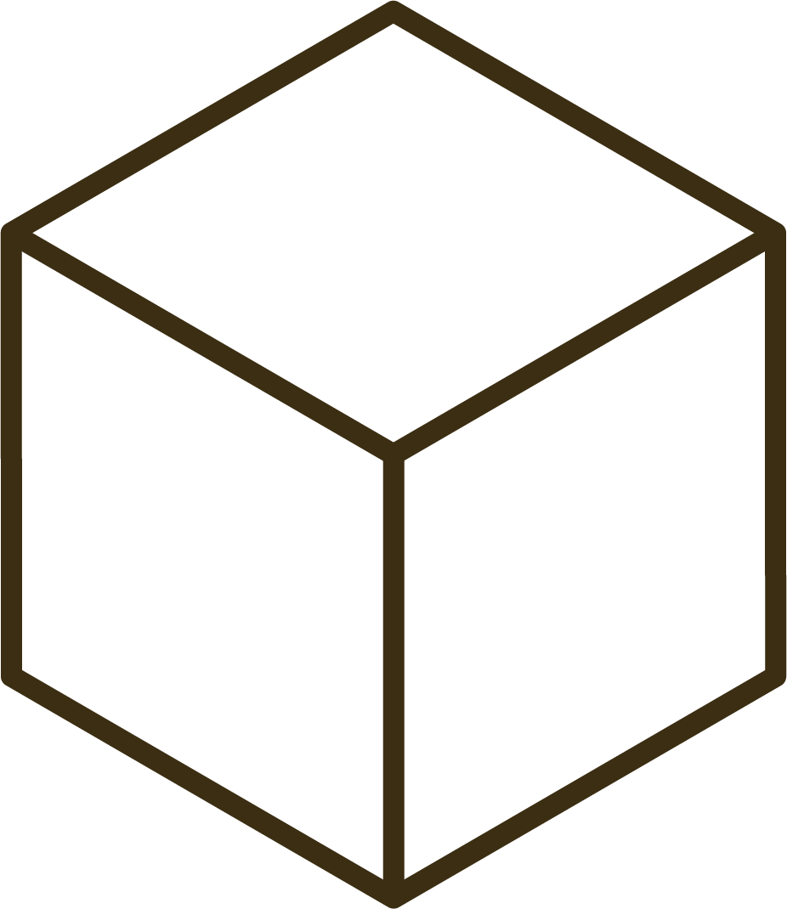


Docker
We can use Docker to distribute software, as an alternative to installing the software directly on a host machine.
Suppose we want to install a tool like Git on our VM. We can:
01
Install Git directly on our host.
02
Download a container that has Git inside of it and use Git from the container.

Slide 58
While downloading a container with Git adds a whole layer of indirection, it also eliminates platform and version issues.

Slide 59
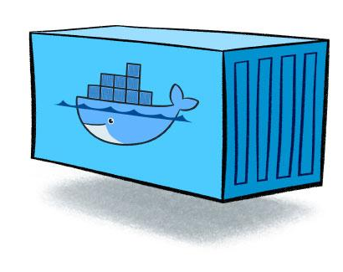
Git Example
We can use the same container on any machine where you use Git, and it will work identically.
While we can't guarantee that software installed directly will behave identically across different machines, we can guarantee that the same container will.
This is usually not an issue with Git in particular, but it is a significant source of bugs with other software.

Slide 60
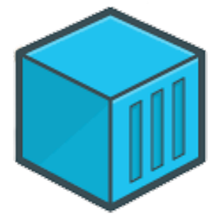
Git Example
We can more easily install multiple versions of a tool side-by-side.
Rather than managing several versions of a single software on a machine, we can have one container for each version we need.
This is useful if we are working on several different projects at once, each needing a different version of the same software.
This is actually an extremely common use case among developers, operations, and cloud engineering specialists.

Slide 61
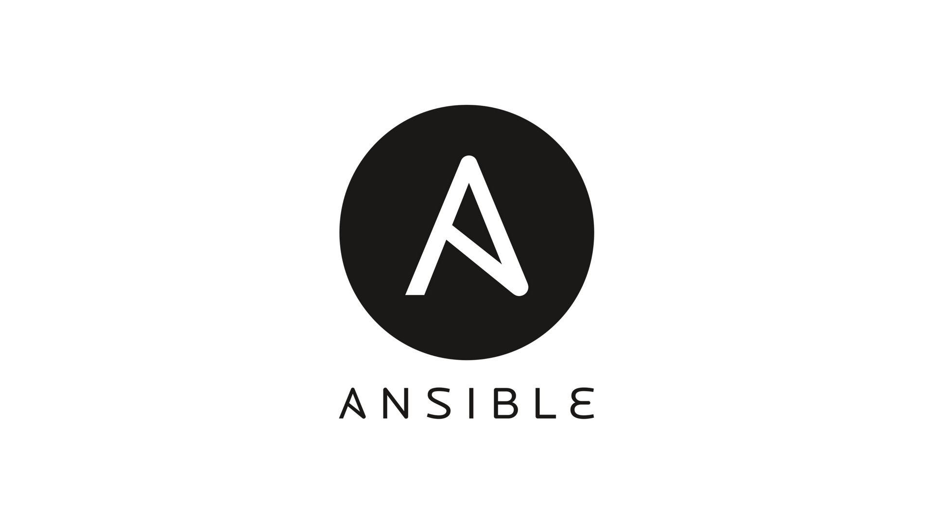
Docker Demo Setup
In the following demo, we will use Docker to install Ansible, a provisioning tool, to ensure our provisioning scripts run identically everywhere they use them.
This further ensures our configurations will do exactly the same thing every time we run them, by eliminating as much variability between configurations as possible.

Slide 62
Docker Demo

Slide 63
Activity: Containers
In this activity, you need to configure your jump box to run Docker containers and install a container.
15 Minutes

Slide 66
Now that we have our jump box running an Ansible Docker container, we will go over provisioners and configure this jump box to connect to other servers so it can configure them.

Slide 67
Infrastructure as Code
Infrastructure as code (IaC) is the concept of defining all of our equipment and network with code. When using virtual machines and containers, almost every server, database, workstation, and other component in your infrastructure can be individually defined with code.

Slide 68


Infrastructure as Code
When a particular piece of the infrastructure is needed, we can run the code that defines that thing and it will be up and running within a few minutes.
IaC allows us to clearly build in security protocols from the ground up.
If a server is found to be vulnerable, it’s easy to
change the code that created the server and
build in a fix.
(Source)

Slide 69

IaC Change Management
IaC is important for keeping track of the changes we’ve made. When we create code that contains the configuration of a server, that code can be version controlled and easily audited.
Notes:
AdobeStock_293264981

Slide 70
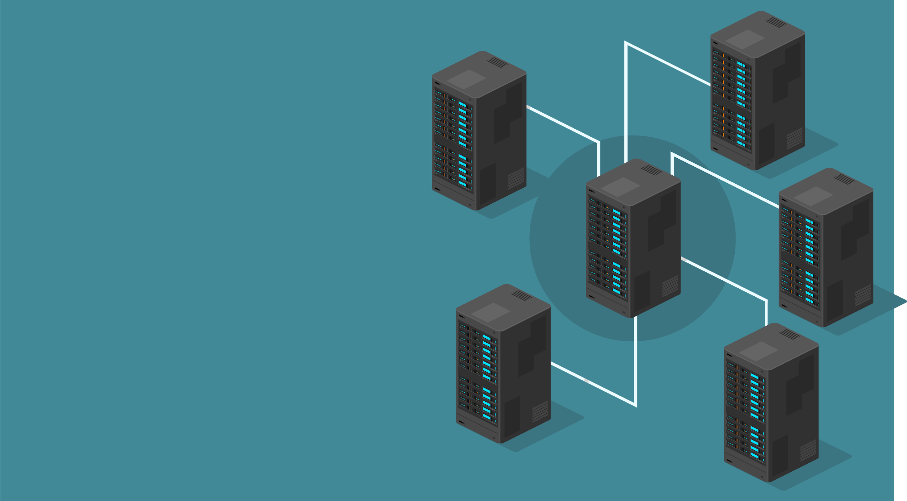
IaC Change Management
Rather than backing up the server and its settings, servers can send logs to a central database. This way, the only things needing backing up are small text files of the code that defines the servers.
Code configuration changes can be deployed or reversed as needed.
If an update causes a problem, we can use version control to reverse the code to its previous state and redeploy.

Slide 71
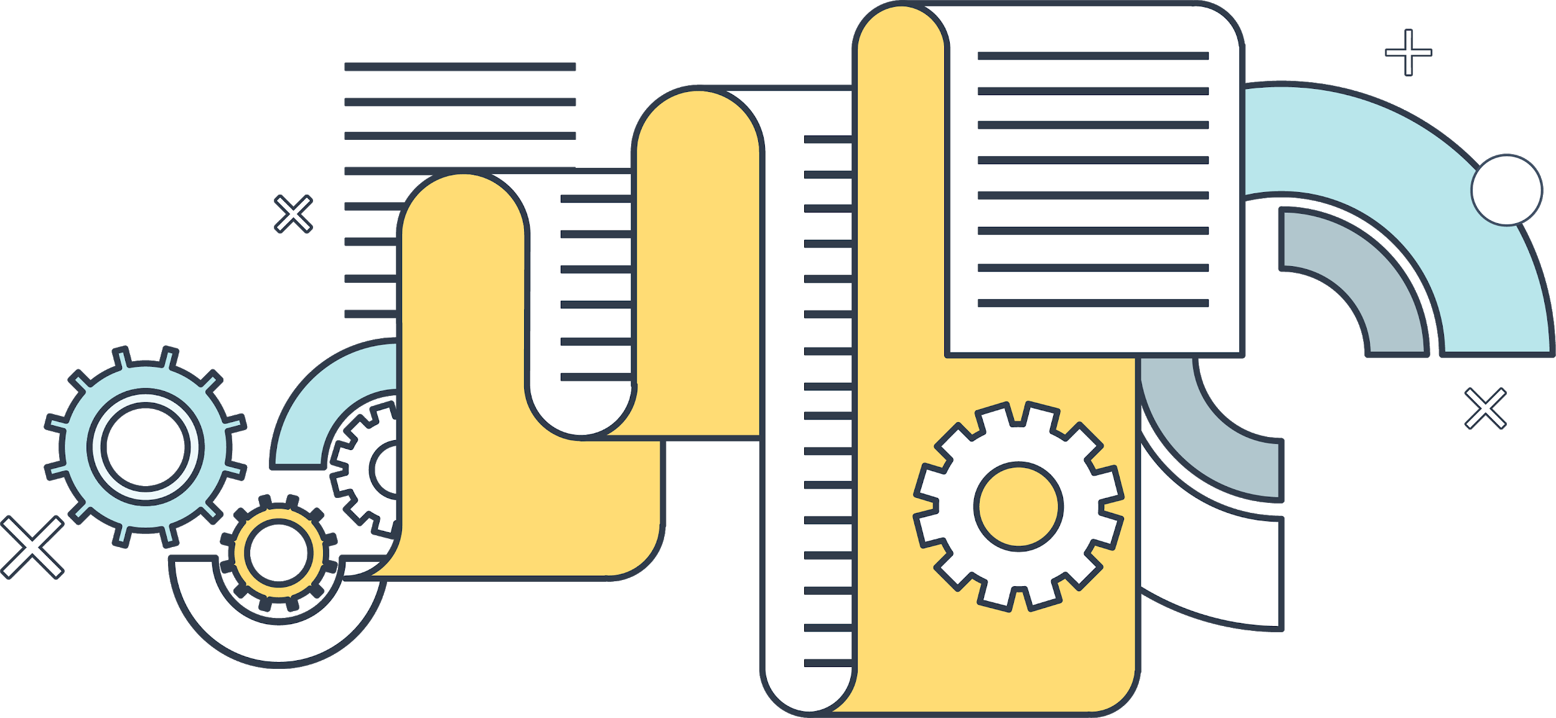
IaC Change Management
In order to see what changes are made to a server, we only need to look at what changes the code makes.
Often this code is written in a
very easy-to-read language, so we only need minimal documentation to understand any given configuration.
Notes:
shutterstock_234317428

Slide 72
Provisioners
A provisioner is a software application used in IaC setups used to make automated configuration changes to computers.
Provisioners focus on bringing a server to a certain state of operation.
Once the desired state of a server is documented with code, that code can be run on one server, 100 servers or 10,000 servers within a few minutes.
Changes made by a provisioner are created using text files, usually written in YAML or JSON.
Common provisioners include Ansible, Puppet, and Chef.

Slide 73
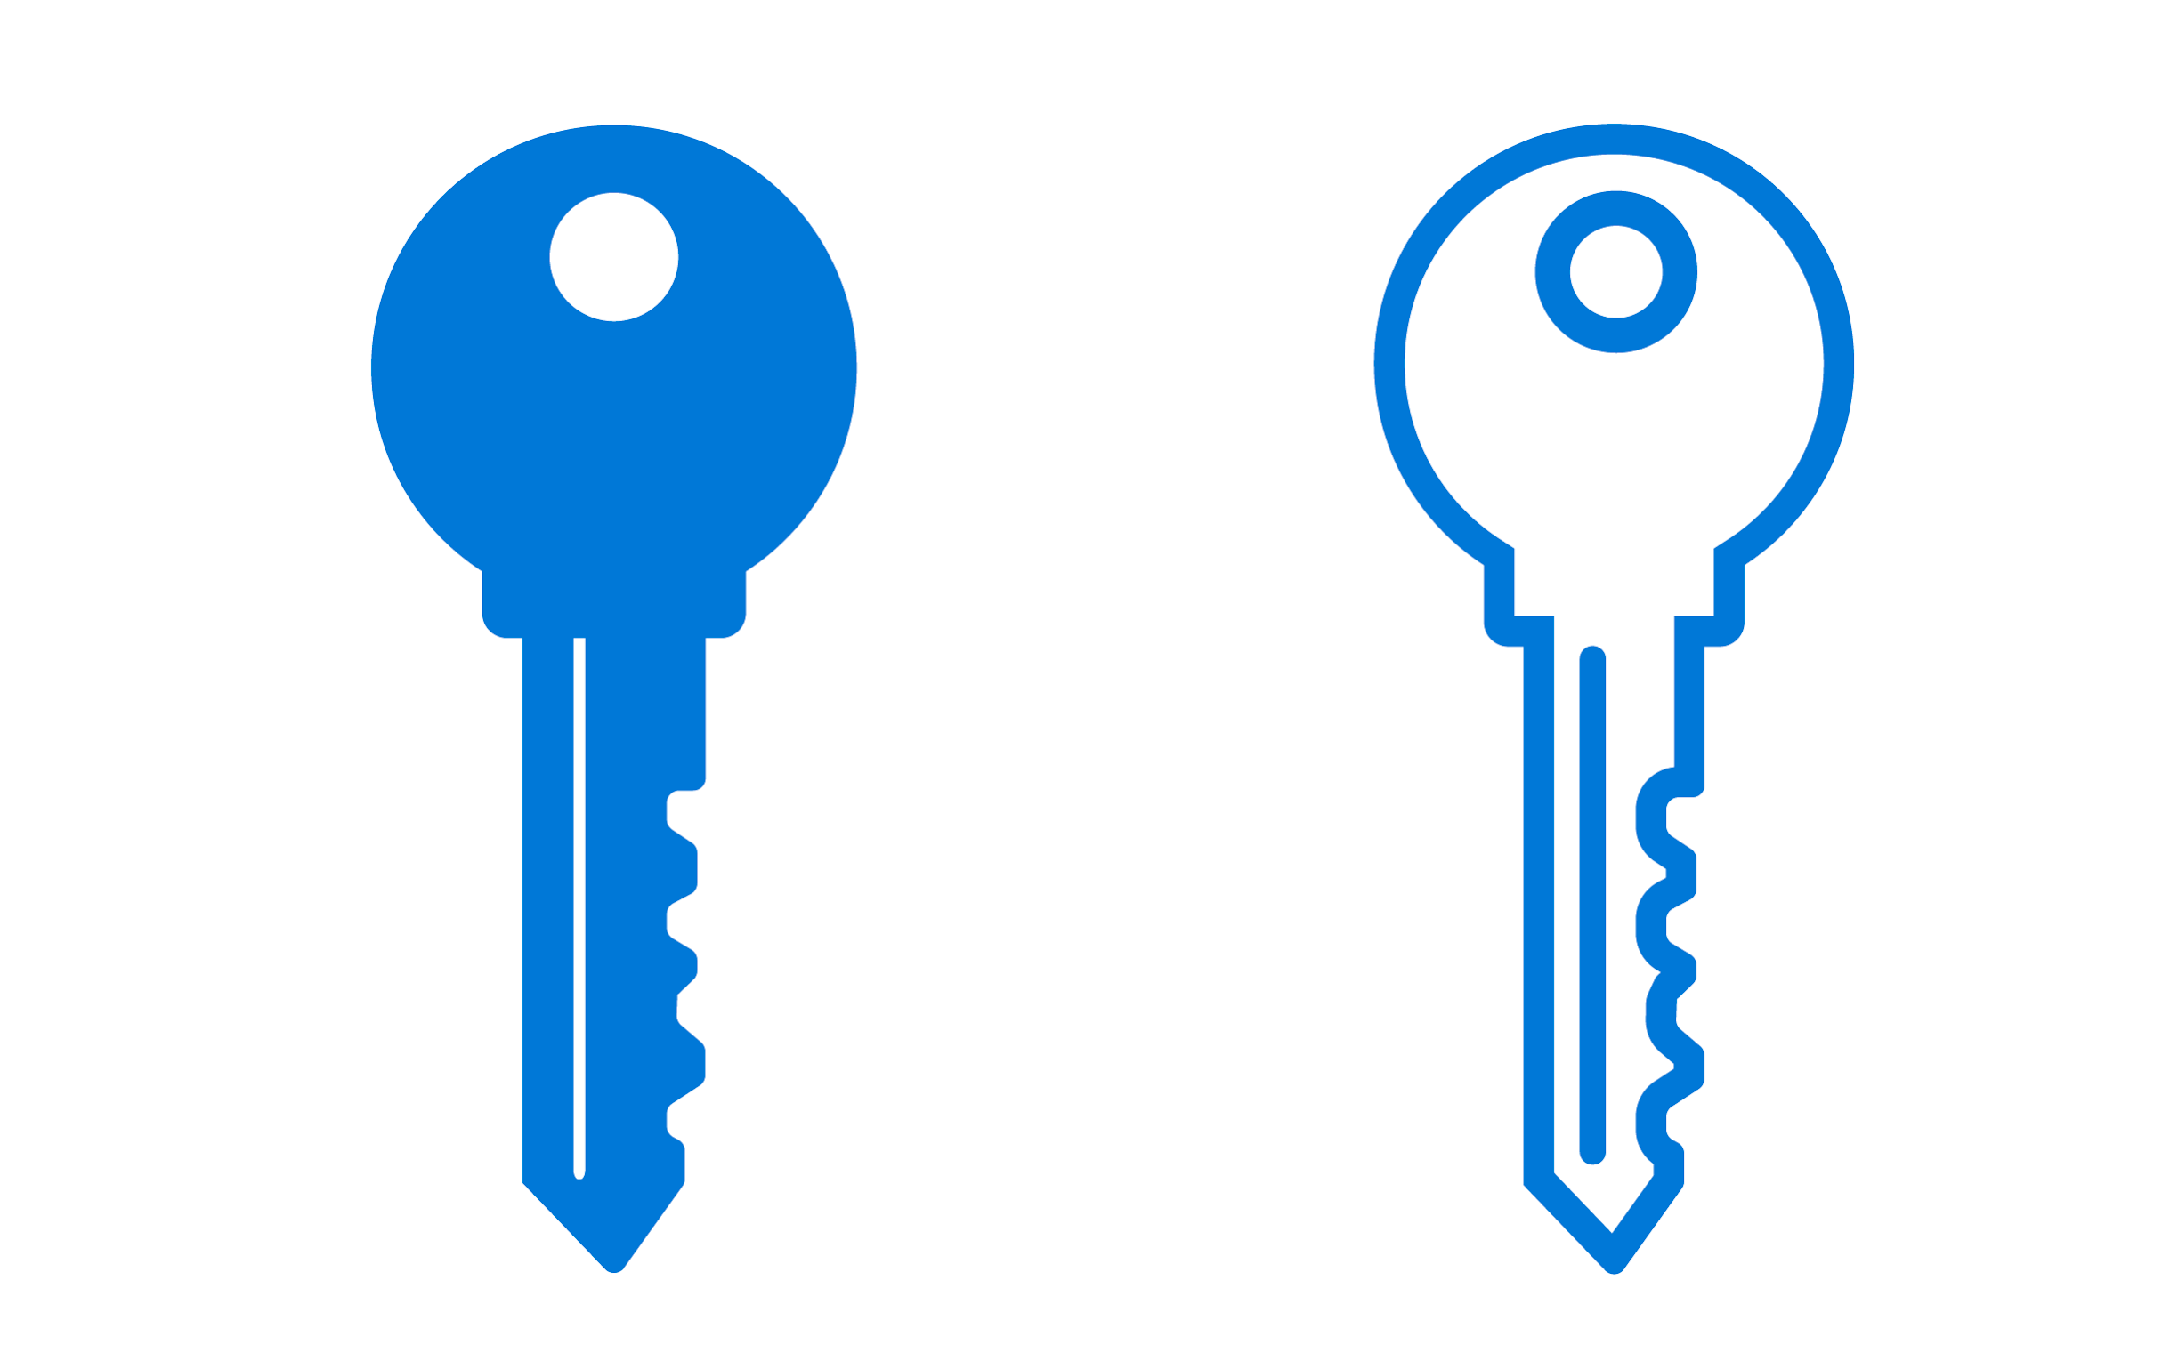
Container and Provisioner Demo
In the following demonstration, we will explore Docker and use our Ansible container to connect to a new VM.
This means we need to create an SSH key pair on the Ansible container and use that SSH id_rsa.pub file to create a new VM in Azure.
Notes:
AdobeStock_59056885 AdobeStock_61123353

Slide 74
Container and Provisioner Demo

Slide 75
Activity: Provisioners
In this activity, you will launch a new VM from the Azure portal that can only be accessed using a new SSH key from the container running inside your jump box.
25 Minutes

Slide 77
Daily Checklist
By the end of today, you should have completed the following critical tasks:
Docker is installed and running on the jump-box.
The cyberxsecurity/ansible Docker container is running on the jump-box.
The security group has a rule that allows the jump-box SSH access to the vNet.
An SSH key created from inside the Ansible container that has no password.
The Web VM's password has been reset using the SSH key from the Ansible container.
Ansible is able to make a connection to both Web VMs.

Slide 78

Don’t forget to power off your machine!

